Slide 1

Abusing Outlook Part II

Slide 2

#whoami
👉 Chirag Savla
👉 Twitter – @chiragsavla94
👉 Interest area – Red Teaming, Application Security, Penetration Testing
Blog – https://3xpl01tc0d3r.blogspot.com

Slide 3
If someone else can run arbitrary code on your computer, it's not YOUR computer any more.
— Rich Kulawiec

Slide 4
Lab Details
Domain Controller (2k12) – 10.0.2.15
Exchange Server 2013 (2k12) – 10.0.2.16
Domain Client (Win 10) – 10.0.2.22
Win 10 – 10.0.2.9
Kali Linux – 10.0.2.10

Slide 5
Agenda
Glimpse of Abusing Outlook Part I
Covert C2C server using outlook
Outlook as Detonator
Detection / Prevention of such attacks

Slide 6
Glimpse of Abusing Outlook Part I
Gain Credentials
Abuse Homepage feature of Outlook
Abuse Rule feature of Outlook
Abuse Forms feature of Outlook
Detection / Prevention of such attacks

Slide 7
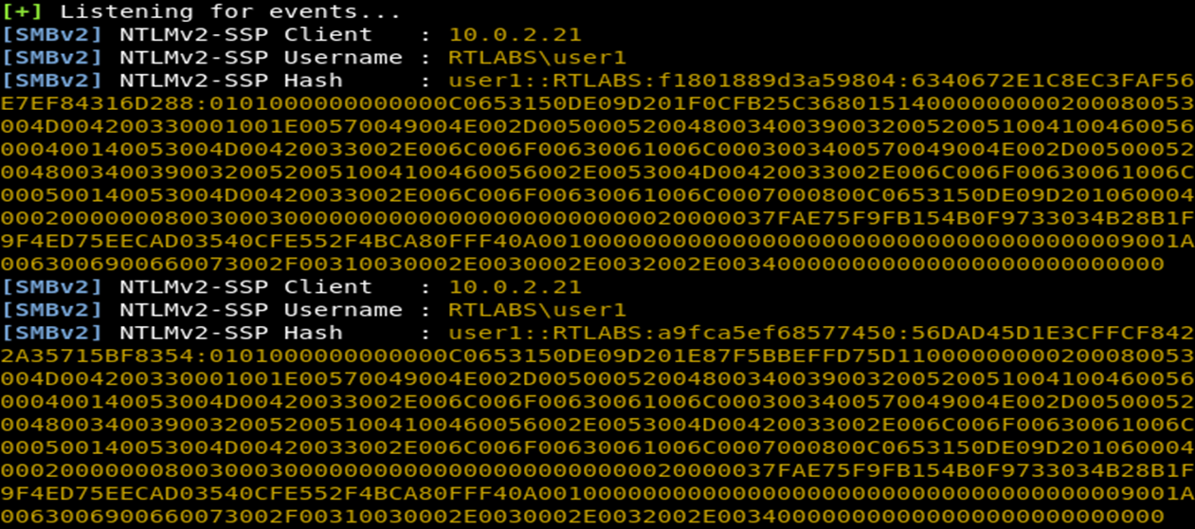
Gain Credentials

Slide 8
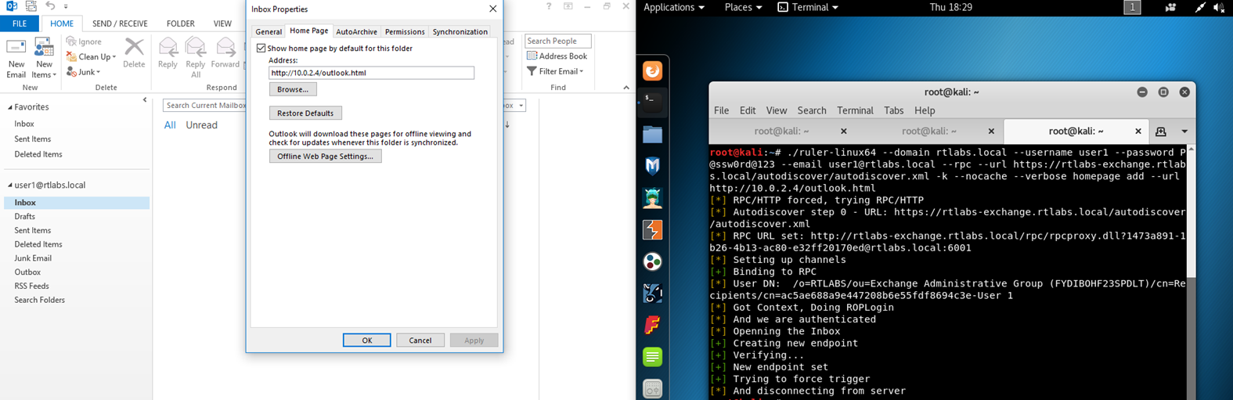
Abuse Homepage feature of Outlook

Slide 9
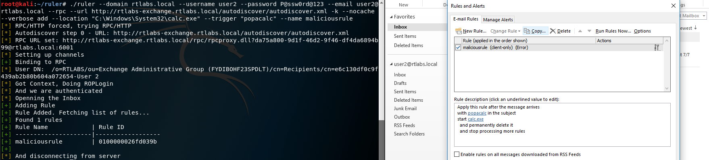
Abuse Rule feature of Outlook

Slide 10
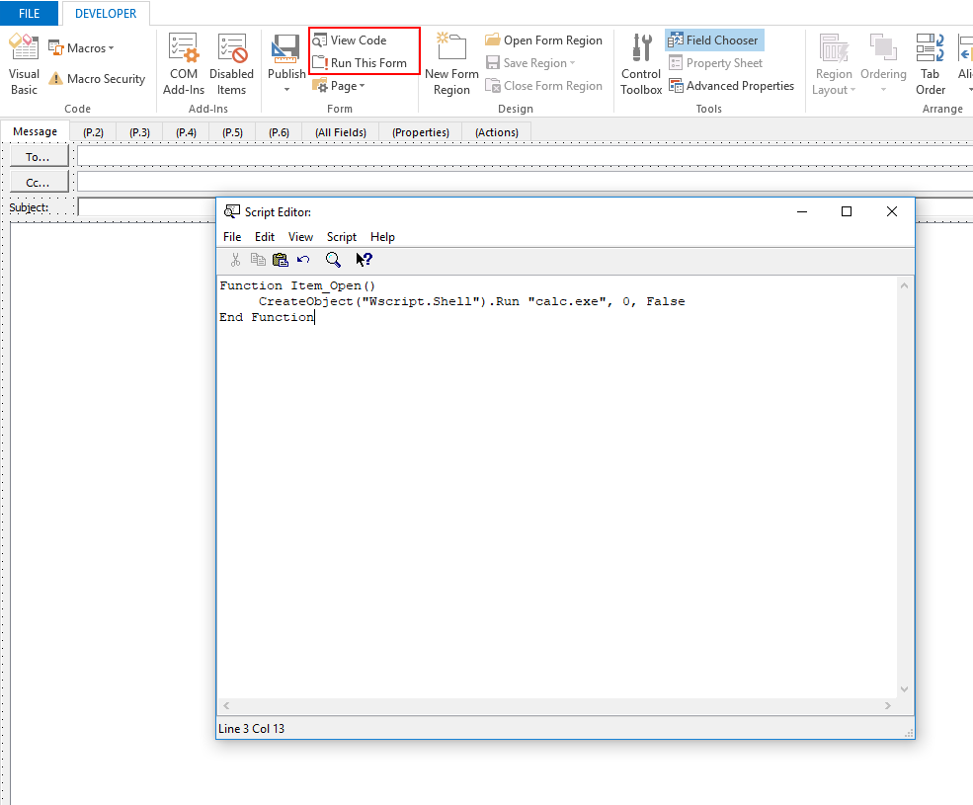
Abuse Forms feature of Outlook

Slide 11
Detection / Prevention of such attacks
Credential Theft
Monitor and block all outwards communications on port 445/tcp, 137/tcp, 139/tcp, along with 137/udp and 139/udp.
Block NT LAN Manager (NTLM) Single Sign-on (SSO) authentication.
Always use complex passwords, that cannot be cracked easily even if the hashes are stolen.
Outlook Attacks
Use notruler tool for detecting attacks which are performed using ruler.
Apply the security patches.
Enable Attack Surface Reduction Rules (ASR) in exploit guard. Note:- Exploit Guard ASR is only supported in windows 10 enterprise edition 1709 and above versions and windows server 2016.

Slide 12
Covert C2C server using outlook
Getting access to an internal network is always great, keeping this access can be a whole other challenge.
At times we want to fly below the radar and ensure our access doesn’t get detected or blocked by traditional network based solutions.
To this end, communicating directly through an Exchange server can be very beneficial and solve both challenges

Slide 13
Covert C2C server using outlook
👤Attacker
Exchange
👤Victim

Slide 14
Demo Time
This is not a rocket science.

Slide 15

Outlook as Detonator

Slide 16
Outlook as Detonator
Create macro file which contains our payload & trigger.
Send the macro file to the victim.
Send the trigger email.

Slide 17
Outlook as Detonator
First part of our macro payload will contain the script which will read / monitor users emails.
Second part of our payload will contain the script which can automate / bypass the outlook security dialog box settings.
Third part of our payload will contain our #PSEmpire stager which will be executed once it receives the Email with trigger keywords.

Slide 18
Outlook as Detonator
Once macro code is executed on the system it will create 3 xml files. This xml files will contains our payloads which are describe in the previous slide.
Once the xml files are stored we will use MSBuild to execute our payloads from xml files.
First 2 payloads(Trigger Script / Outlook Security Bypass Script) will be executed as soon as macro executes.
Once the victims receives the trigger email it will execute our stager payload.
MSBuild can also help us to bypass Application Whitelisting(Applocker).

Slide 19
Demo Time
This is not a rocket science.

Slide 20
Detection / Prevention of such attacks
C2C Server
Enable Attack Surface Reduction Rules (ASR) in exploit guard. Note:- Exploit Guard ASR is only supported in windows 10 enterprise edition 1709 and above versions and windows server 2016.
Enable powershell logging and monitor command execution.
Outlook Attacks
Enable Attack Surface Reduction Rules (ASR) in exploit guard. Note:- Exploit Guard ASR is only supported in windows 10 enterprise edition 1709 and above versions and windows server 2016.
Disable macro’s files deliver on email gateway.
Monitor the usage of #lolbins.

Slide 21
THANKS!
Any questions?
You can find me at @chiragsavla94

Slide 22
Credits
Special thanks to @_staaldraad & @mr64bit who help me in getting the bug fixed and supported me while creating the demos.
Thanks to @NullMumbai for granting me the privilege to present.

Slide 23
Reference
https://www.youtube.com/watch?v=av0OOr9Aj18
https://github.com/colemination/PowerOutlook
https://sensepost.com/blog/2017/liniaal-empire-through-exchange/
http://txtwizard.net/compression
https://www.youtube.com/watch?v=tuc8cwOAAcA
https://github.com/giMini/PowerMemory/blob/master/RWMC/misc/reverseshell.xml
http://www.source-code.biz/snippets/vbasic/Base64Coder.bas.txt

